Slide 1
影像與聲音辨識的雲端服務產品
2019年6月1日

Slide 2
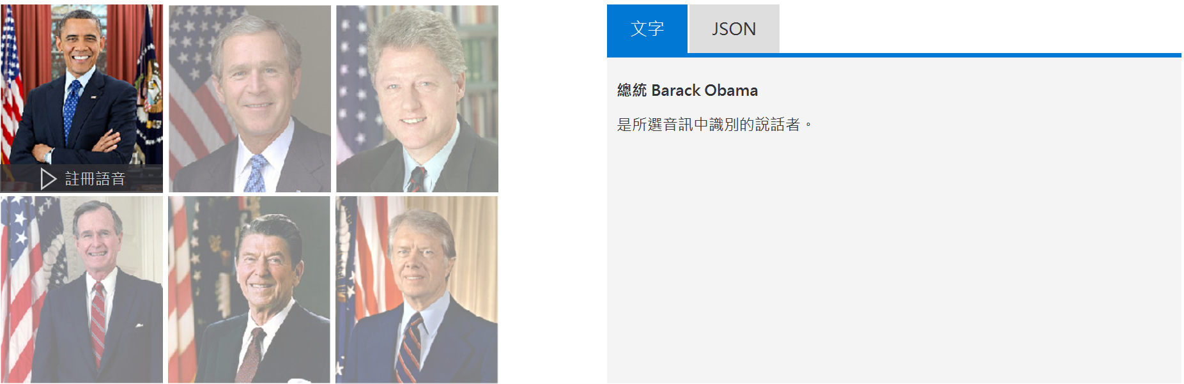
Microsoft Azure說話者識別

Slide 3
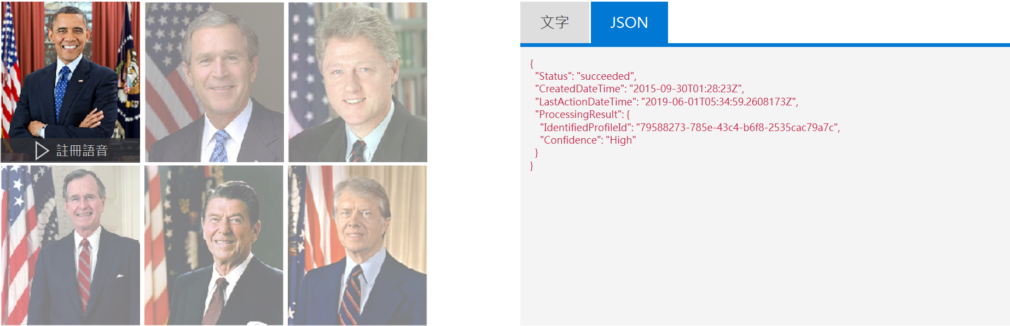
Microsoft Azure說話者識別

Slide 4
Microsoft Azure說話者識別
將音檔資料進行標記後，我們只要播放一段音檔，就能自動辨識出說話者是誰。
在微軟網站上的案例當中，共有六位美國總統，播放他們的聲音出來，該服務就能自動比對出說話的是哪一位總統。
也因此，我認為應該能夠將「說話者辨識」這項服務，推廣延伸到鳥類聲音的辨識。

Slide 5
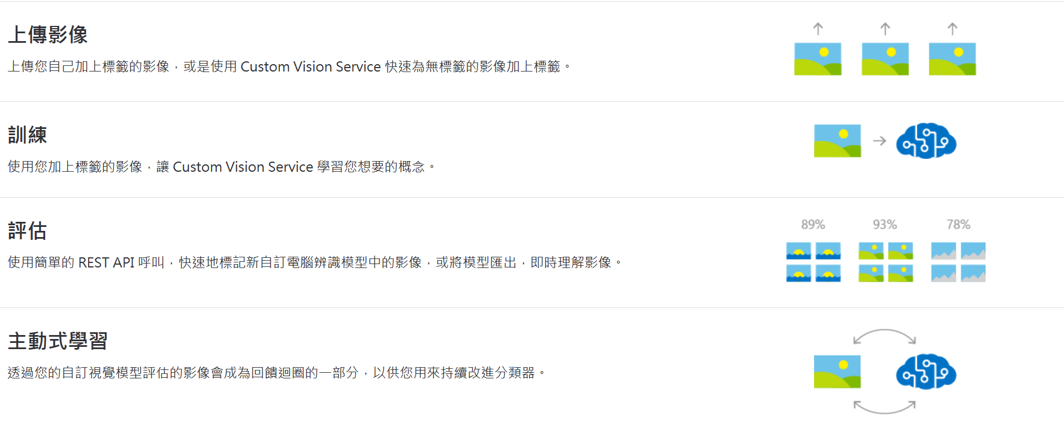
Microsoft自訂視覺

Slide 6
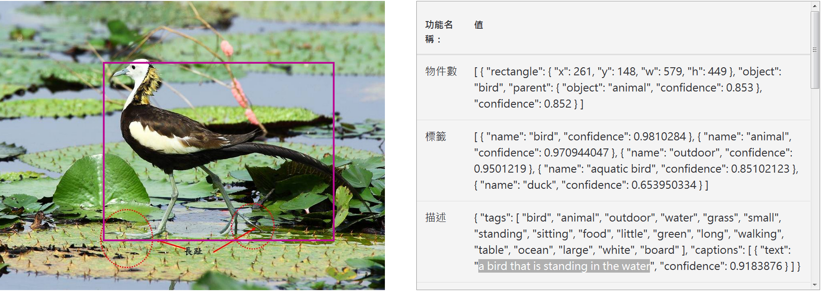
Microsoft電腦視覺
微軟的電腦視覺服務，還能看圖說故事。 A bird that is standing in the water

Slide 7
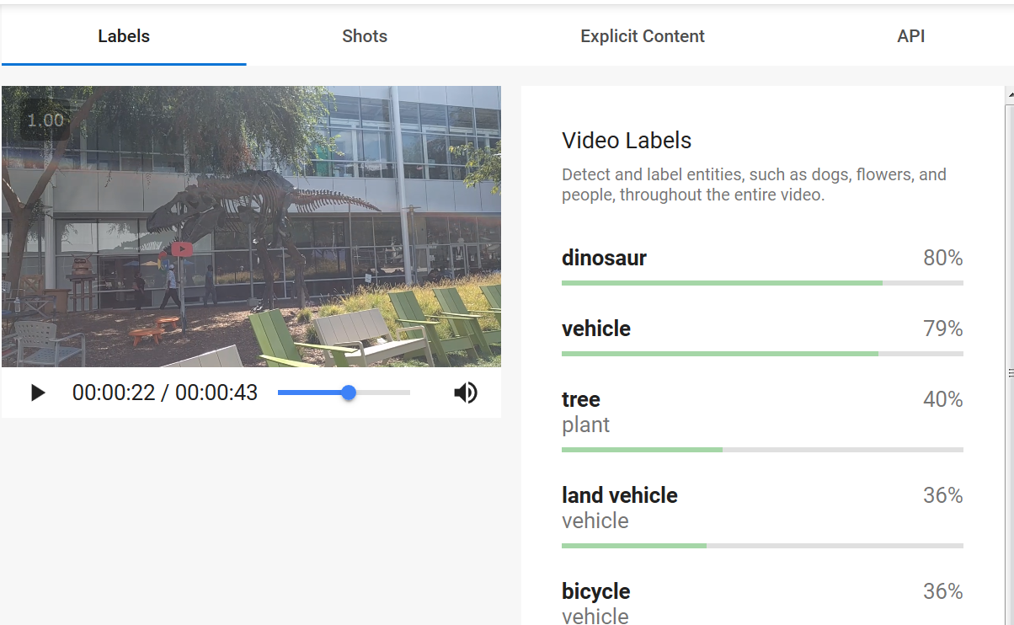
Google Video AI (AutoML Video Intelligence)

Slide 8
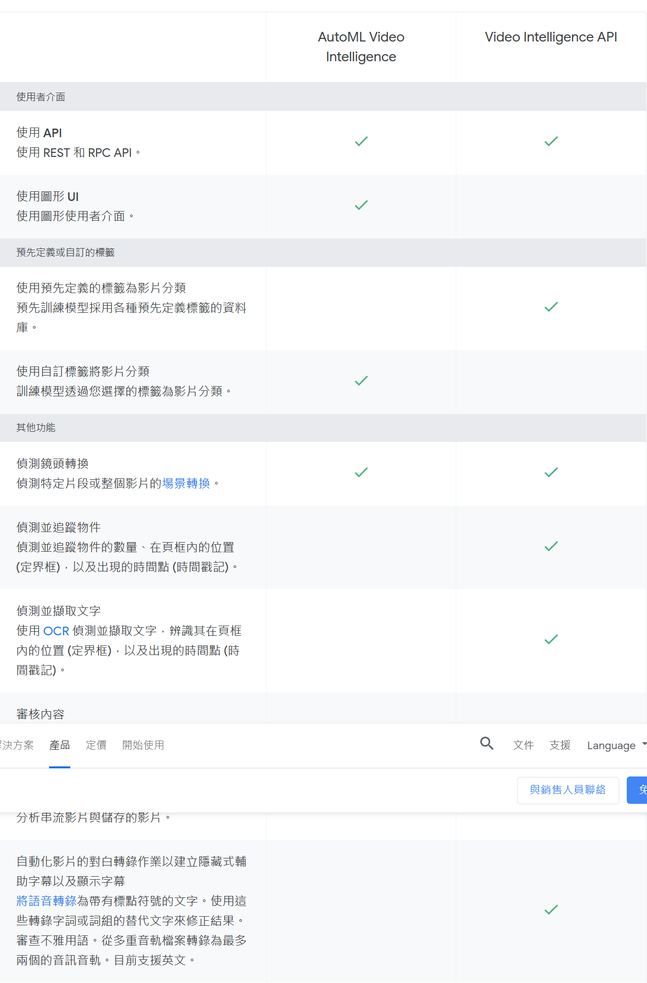
Google Video AI

Slide 9
Google Video AI (AutoML Video Intelligence)
Google Video AI這項服務能夠辨識出影片當中有哪些的物件，並且將它們用文字標記出來

Slide 10
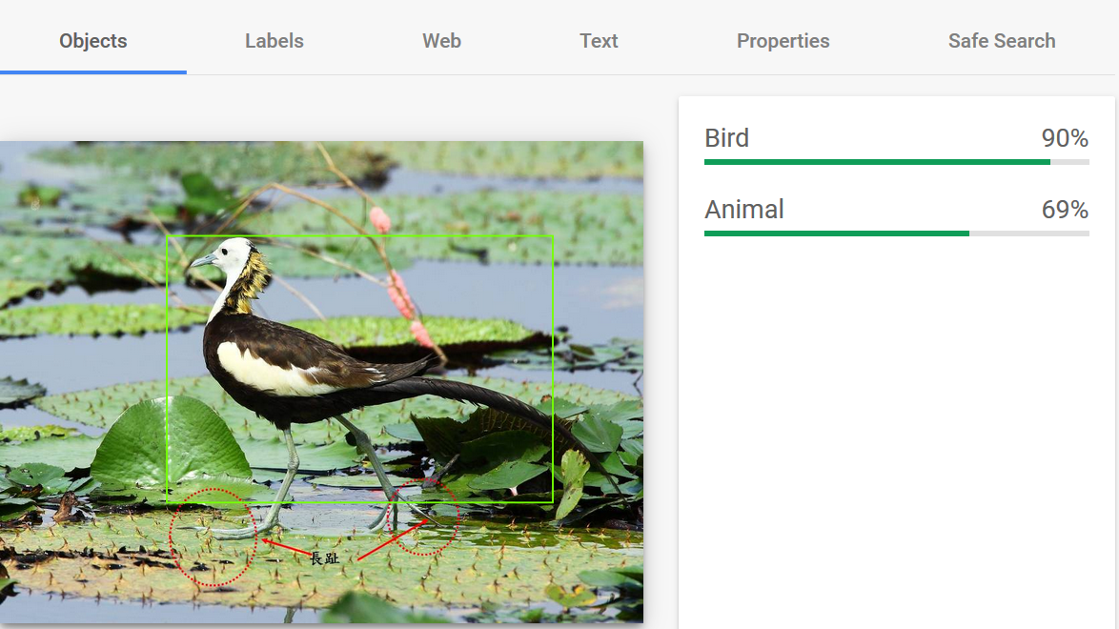
Google Cloud Vision

Slide 11
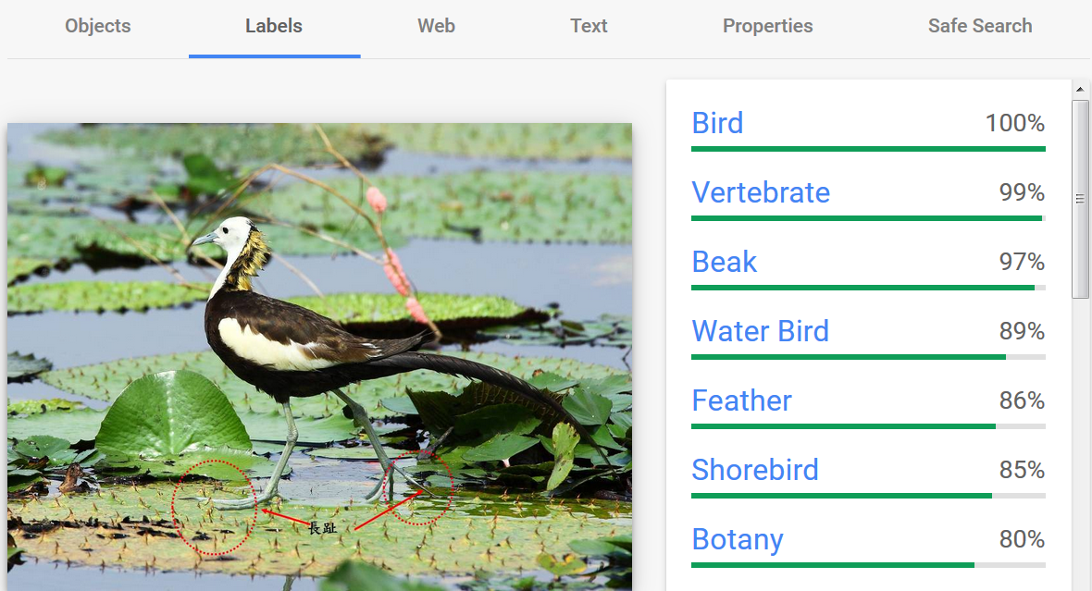
Google Cloud Vision

Slide 12
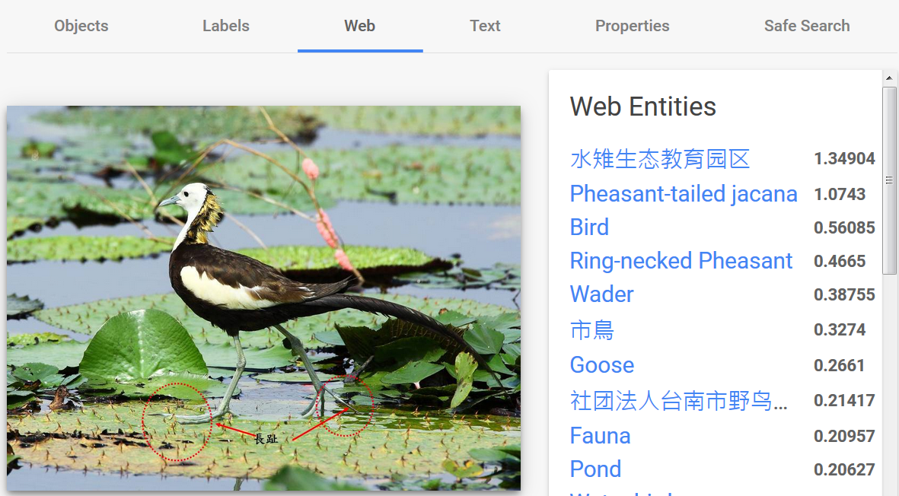
Google Cloud Vision

Slide 13
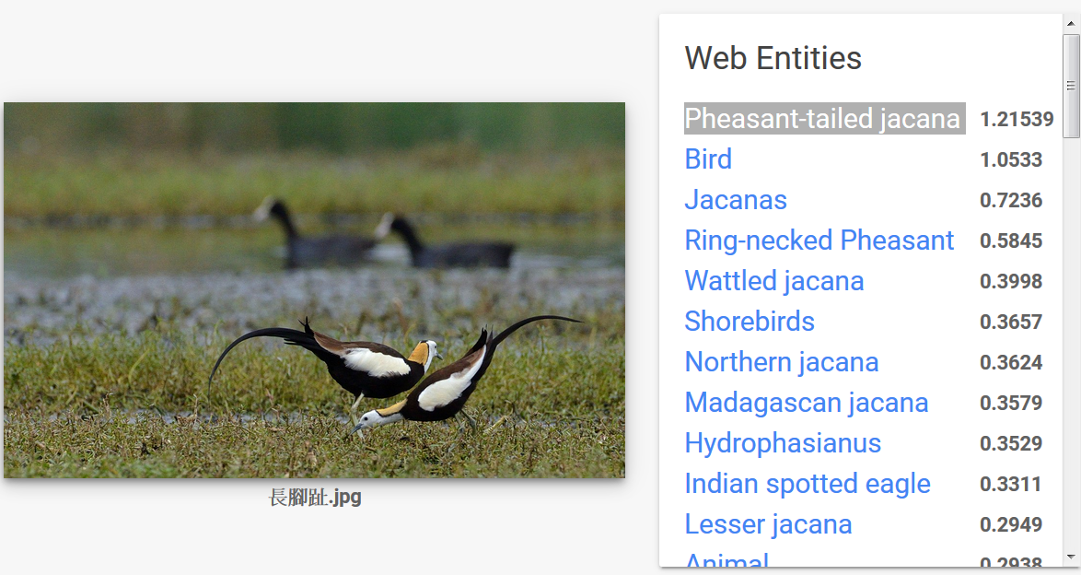
Google Cloud Vision

Slide 14
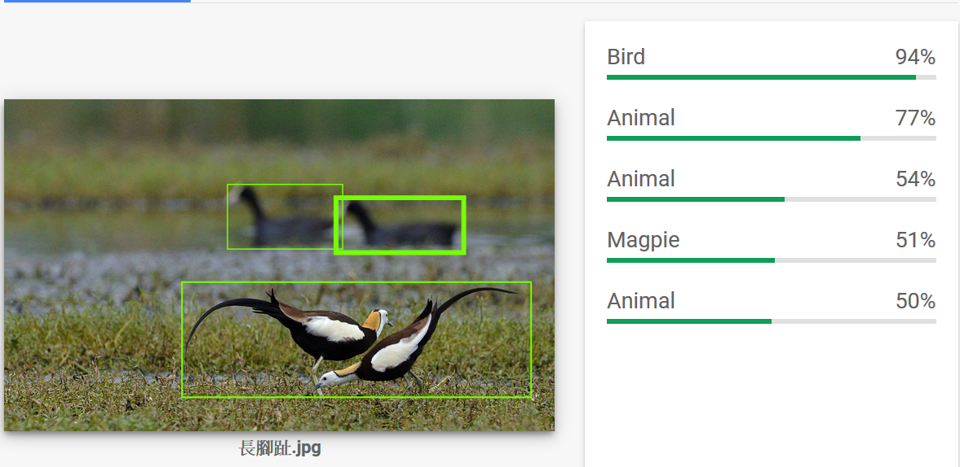
Google Cloud Vision

Slide 15
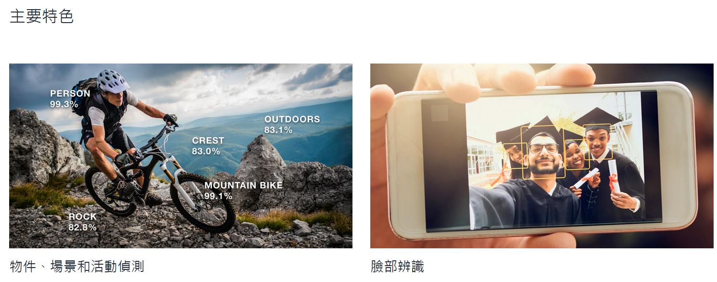
Amazon Rekognition

Slide 16
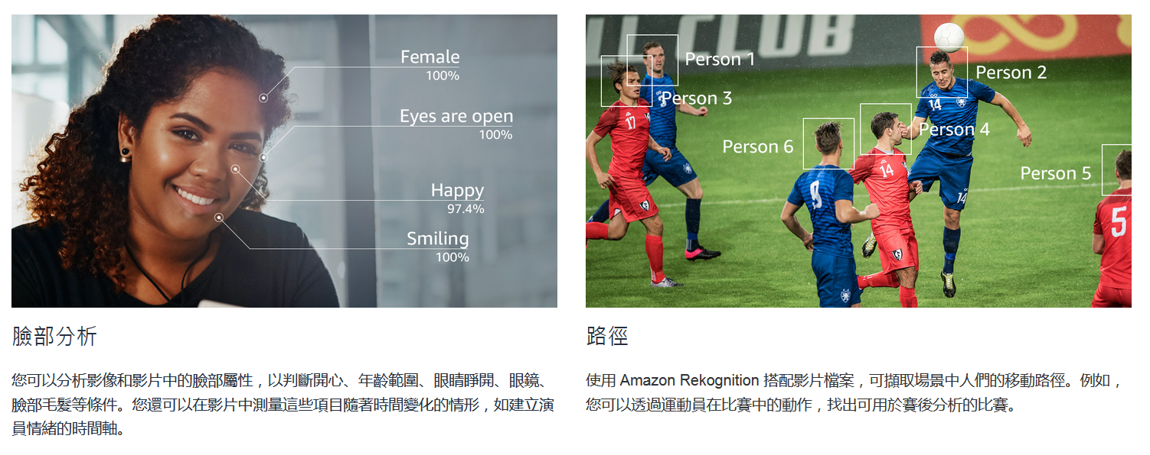
Amazon Rekognition

Slide 17
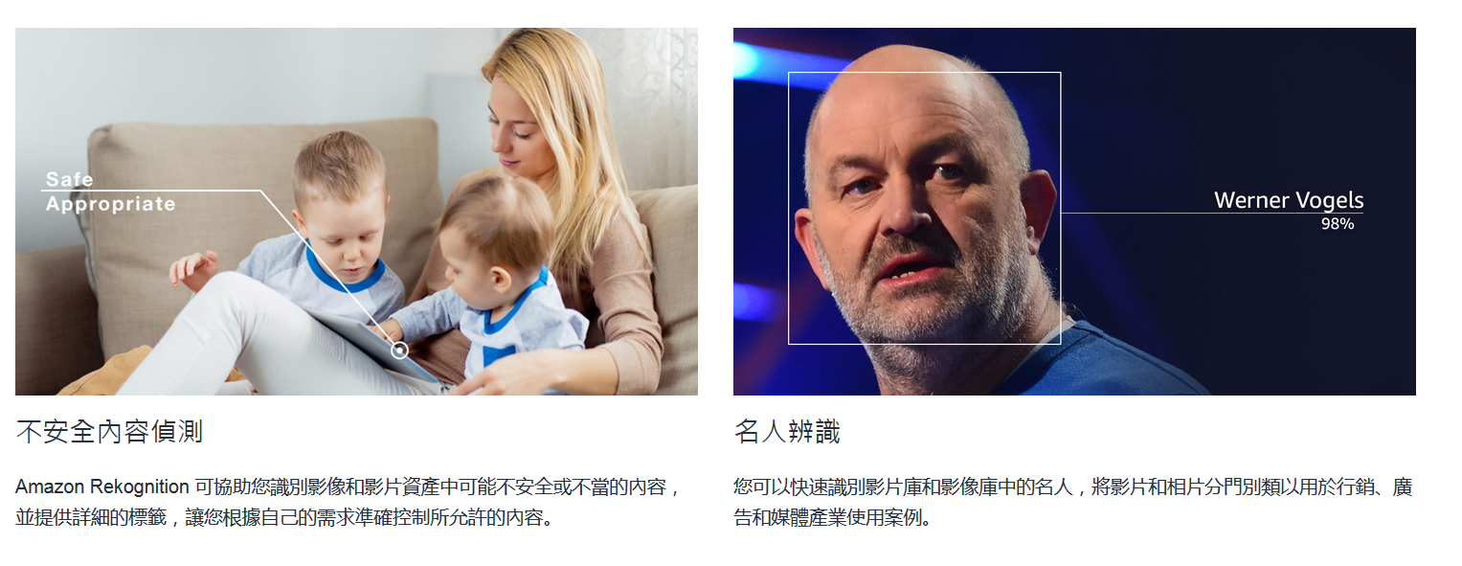
Amazon Rekognition

Slide 18
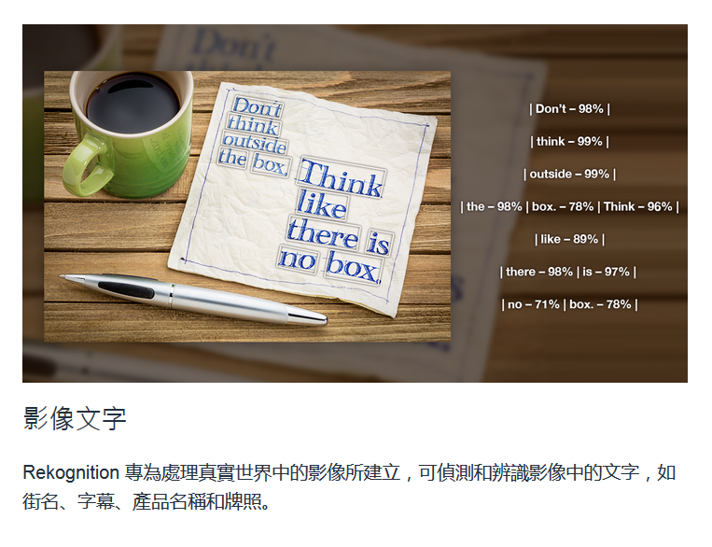
Amazon Rekognition

Slide 19
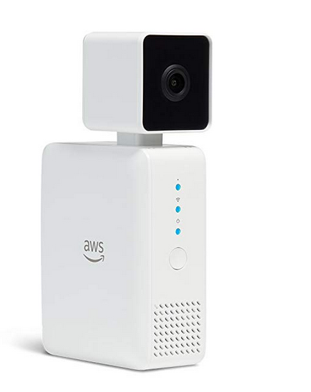
AWS DeepLens - Deep learning enabled video camera for developers

Slide 20
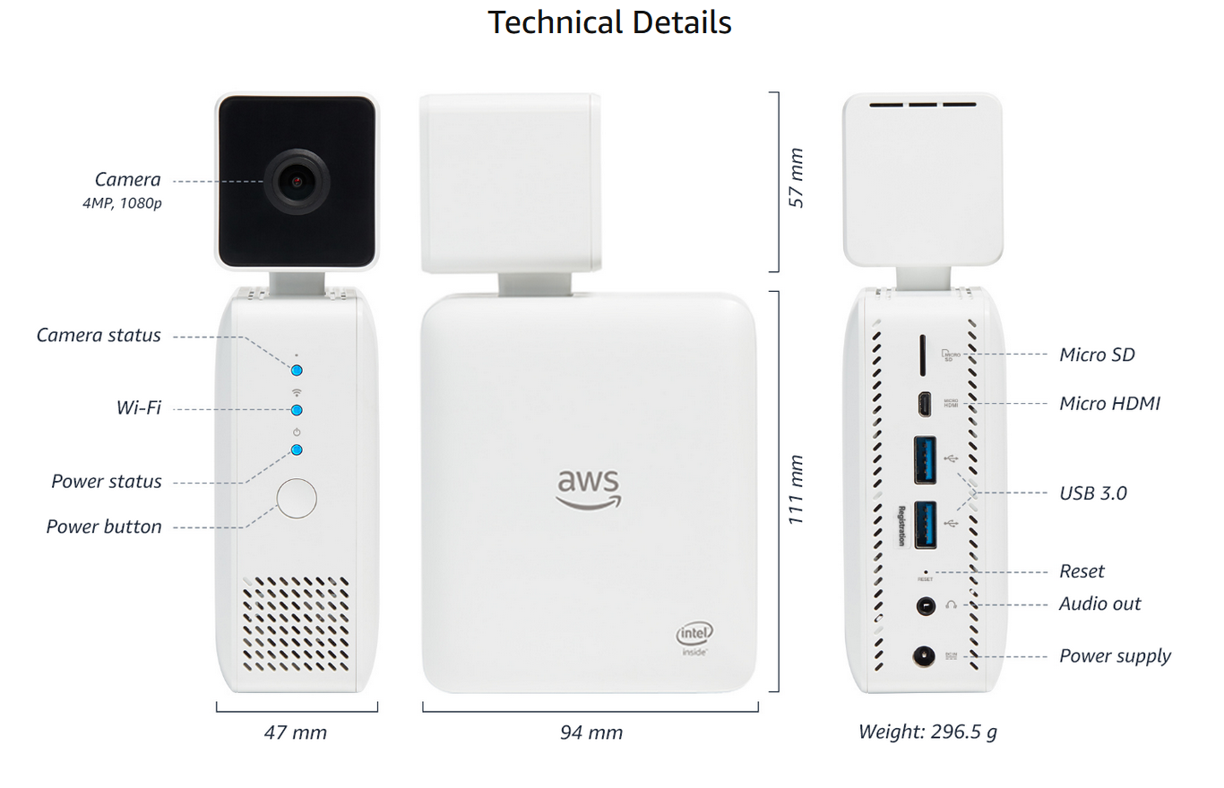
AWS DeepLens - Deep learning enabled video camera for developers

Slide 21
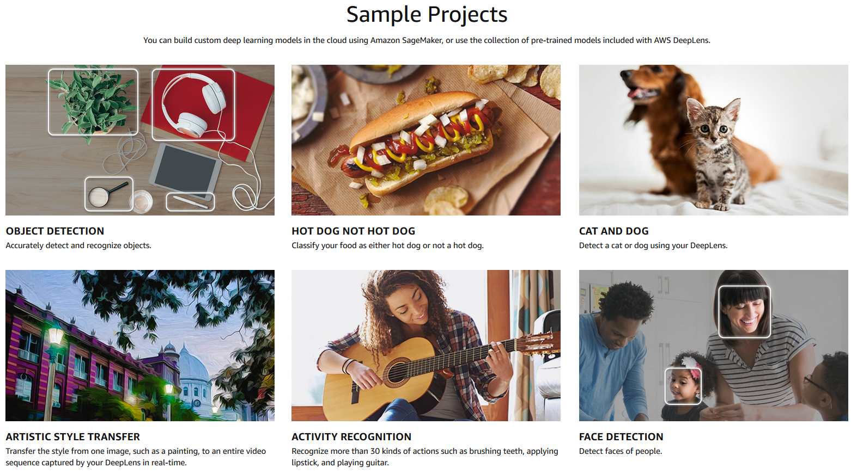
AWS DeepLens - Deep learning enabled video camera for developers

Slide 22
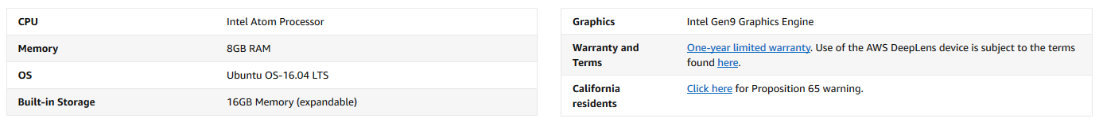
AWS DeepLens - Deep learning enabled video camera for developers

Slide 23
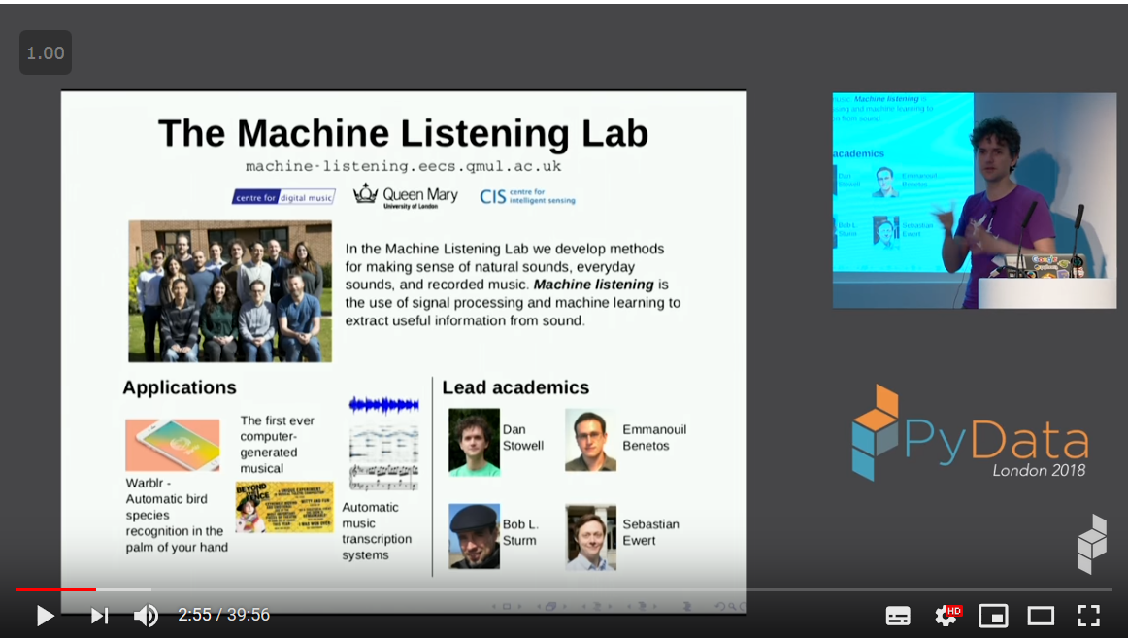
Who's singing? Automatic bird sound recognition with machine learning - Dan Stowell

Slide 24
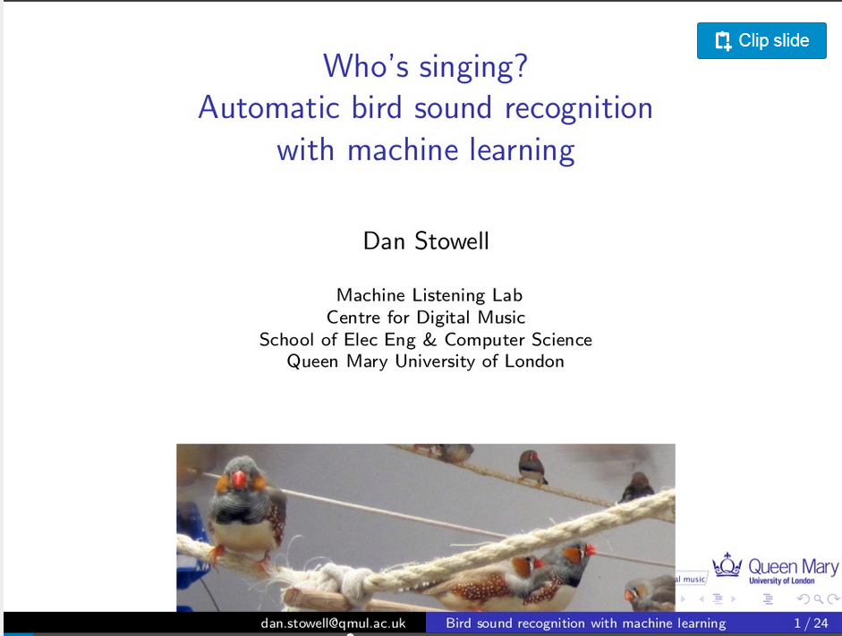
Who's singing? Automatic bird sound recognition with machine learning - Dan Stowell

Slide 25
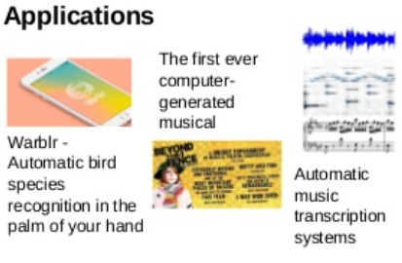
Who's singing? Automatic bird sound recognition with machine learning - Dan Stowell

Slide 26

Who's singing? Automatic bird sound recognition with machine learning - Dan Stowell

Slide 27
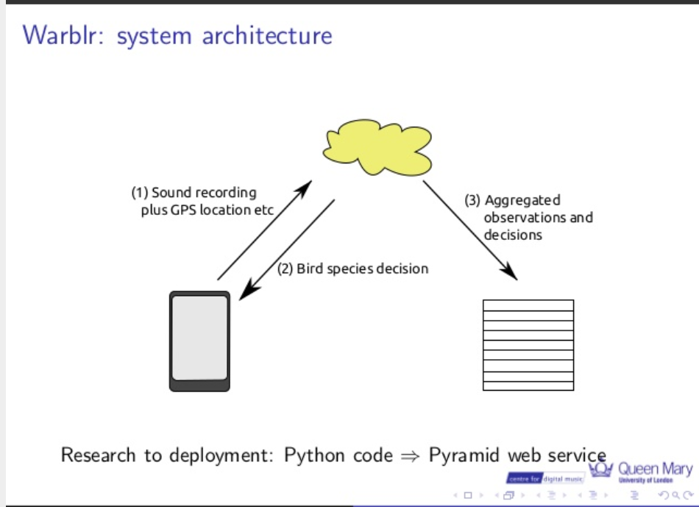
Who's singing? Automatic bird sound recognition with machine learning - Dan Stowell

Slide 28
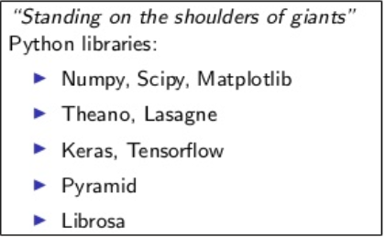
Who's singing? Automatic bird sound recognition with machine learning - Dan Stowell

Slide 29
Bird Audio Detection challenge
http://machine-listening.eecs.qmul.ac.uk/bird-audio-detection-challenge/
音源資料下載

Slide 30
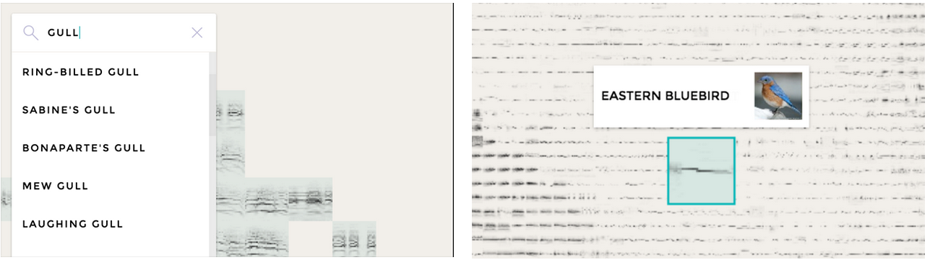
Bird Sounds by Manny Tan & Kyle McDonald | Experiments with Google
https://experiments.withgoogle.com/bird-sounds

Slide 31
Bird Sounds by Manny Tan & Kyle McDonald | Experiments with Google
https://experiments.withgoogle.com/bird-sounds
https://www.youtube.com/watch?v=31PWjb7Do1s

Slide 32
Bird Sounds by Manny Tan & Kyle McDonald | Experiments with Google
https://experiments.withgoogle.com/bird-sounds
Google使用機器學習辨識數千種的鳥類。 電腦只有音源檔，沒有任何的標記資料. 使用t-SNE技術

Slide 33
Bird Sounds by Manny Tan & Kyle McDonald | Experiments with Google
GitHub連結
https://github.com/googlecreativelab/aiexperiments-bird-sounds

Slide 34
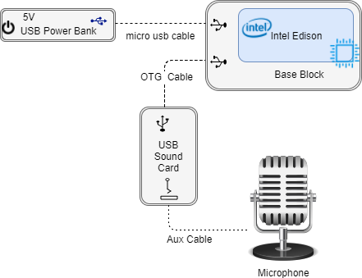
Identifying Birds Using Machine Learning

Slide 35
參考文獻
Microsoft Azure 說話者辨識 :
https://azure.microsoft.com/zh-tw/services/cognitive-services/speaker-recognition/
Microsoft自訂視覺 ：
https://azure.microsoft.com/zh-tw/services/cognitive-services/custom-vision-service/
Google Video AI：
https://cloud.google.com/video-intelligence
Google Cloud Vision：
https://cloud.google.com/vision/?hl=zh-tw

Slide 36
參考文獻
Microsoft 電腦視覺:
https://azure.microsoft.com/zh-tw/services/cognitive-services/computer-vision/
Youtube - Who's singing? Automatic bird sound recognition with machine learning - Dan Stowell
SlideShare - Who's singing? Automatic bird sound recognition with machine learning - Dan Stowell

Slide 37
參考文獻
Bird Audio Detection challenge
http://machine-listening.eecs.qmul.ac.uk/bird-audio-detection-challenge/
Bird Sounds by Manny Tan & Kyle McDonald | Experiments with Google
https://experiments.withgoogle.com/bird-sounds
Identifying Birds Using Machine Learning

Slide 38
參考文獻
AWS DeepLens - Deep learning enabled video camera for developers
Amazon Rekognition

